Slide 1

Besser
Christian Childress | Jason Logerquist | Kristade Swain

Slide 2

Focus
Create new employee suggestion system for Zublin
Employees can quickly and easily notify administration about potential new ideas
Any employee (whether blue or white collar) could suggest an idea
Potential Ideas are rated and ranked
Reviewers decide whether or not ideas should continue or end

Slide 3
Sprint 2 - Goal
Our goal for sprint 2 was to create a more advanced framework and structure for the application and provide usable CRUD operations on the database that both interact with the GUI and the application backend. We also wanted to have a hierarchy of users and have this hierarchy of users be able to perform different tasks and have different permissions. We also wanted to start having actual functionality available for users and have a proper tree of interaction with GUI.

Slide 4
Sprint 2 - Accomplishments
We created an Administration feature for application.
It allows an administrator to create and/or delete user accounts.
We created a solution for users to have the ability to make changes to one of their earlier idea entries.
We successfully created a read-only view for idea entries for reviewer to scroll through.
We created a comment section for the Pending Ideas view, so reviewers are able to see what the other viewers think about an idea before they approve it.
We created a view for anonymous users to also have the ability to submit an idea anonymously.

Slide 5
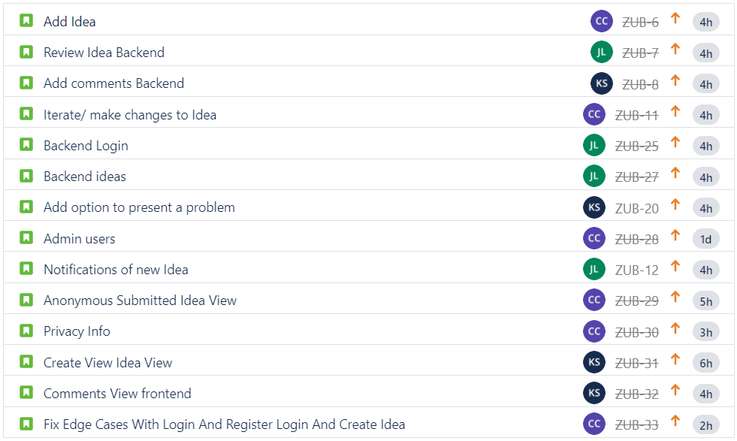
Sprint 2 - Backlog

Slide 6
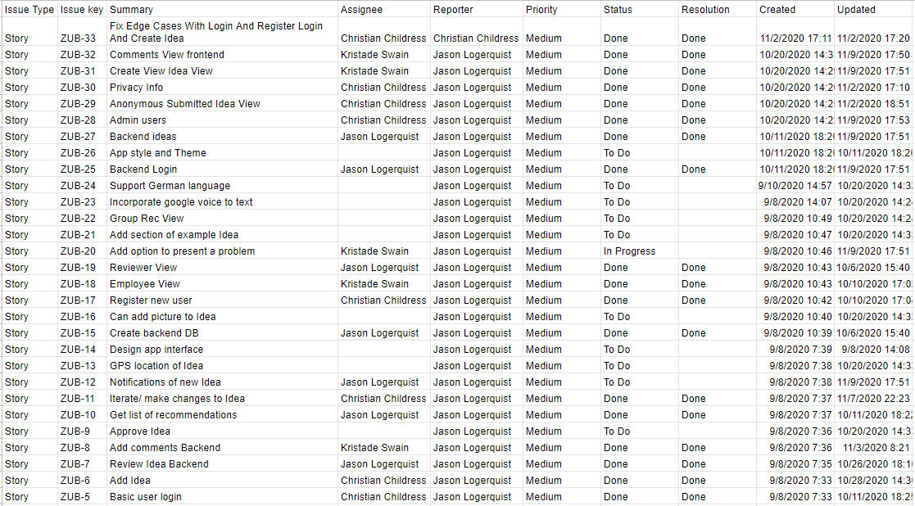
Project - Backlog

Slide 7
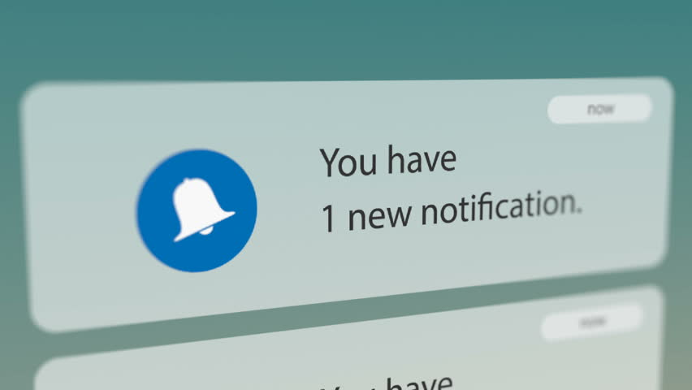
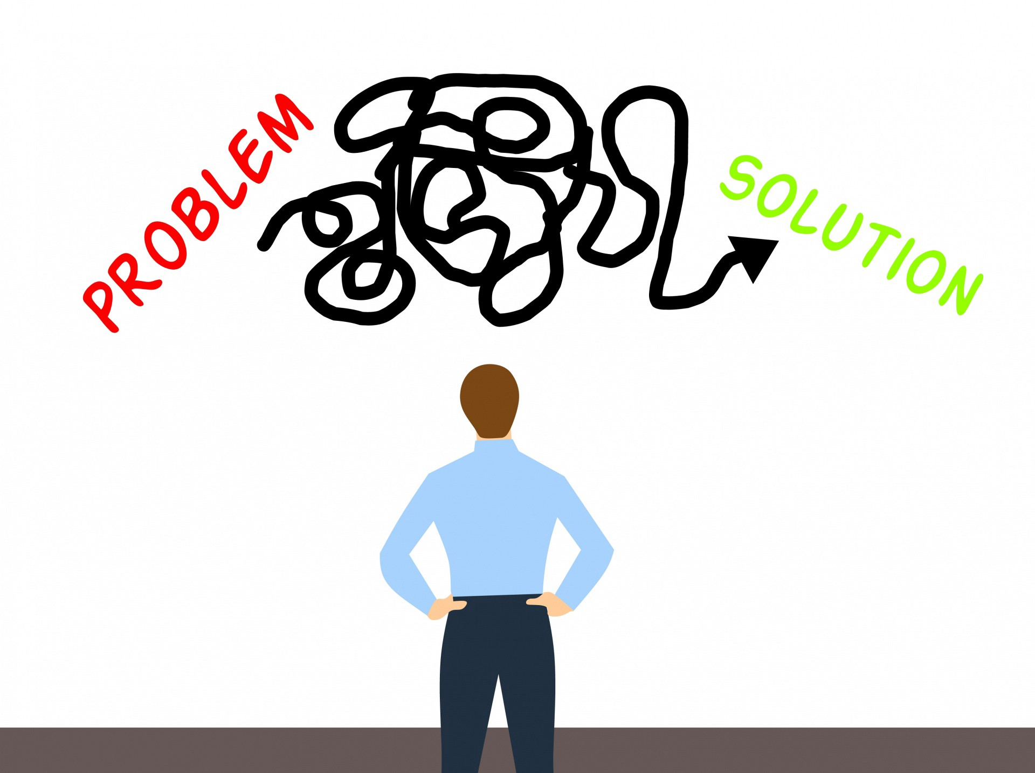
Still Pending...
On Sprint 2, we completed most of the features that we wanted to get accomplished. We have one on our To-Do list and one on our In-Progress list.
Notification of an New Idea:
Will notify reviewers of new ideas.
Add Option to Present a Problem:
Users can present problems they personally do not have a solution for.

Slide 8
A Few Bumps in the Road
Implementing the scroll view.
Struggled with debugging.
Hard to trace through the error code.
Implementation of the Comment View.
One member bagan the view with the wrong layout and constraints.
Another member had to go in and reconstruct the entire Comment View to help the other member.
Reconstructed backend to implement functions, so we could properly create test cases.

Slide 9
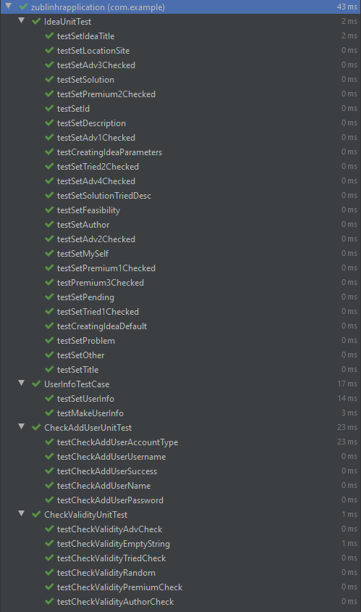
Test Cases - Passing
37/37 tests are passing

Slide 10
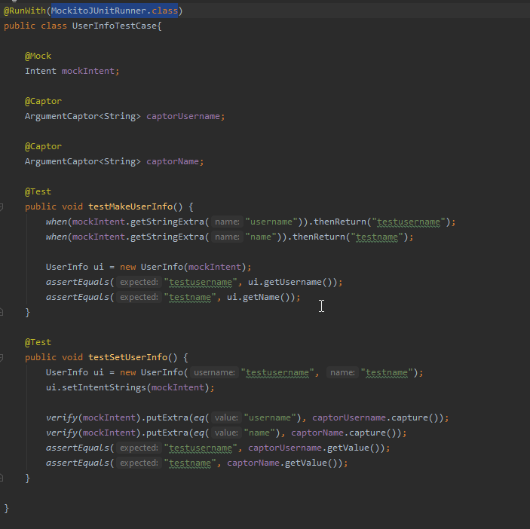
Test Cases - User Info
Theses test cases mock out the Intent putExtra and getStringExtra methods to test out our UserInfo class that handling getting and passing strings between activities.

Slide 11
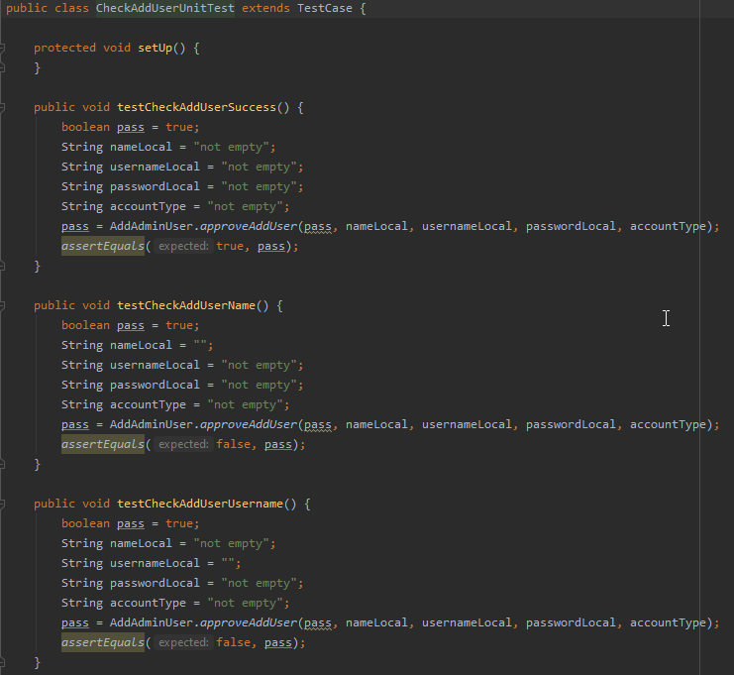
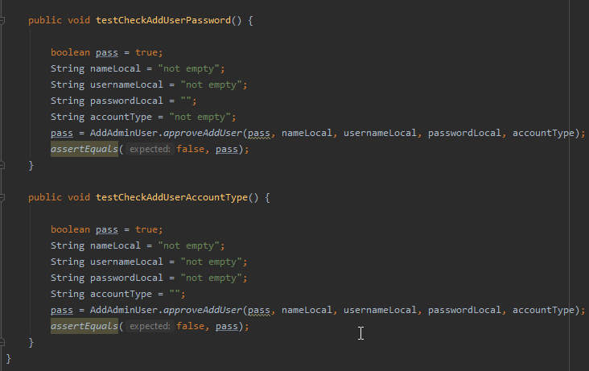
Test Cases - Validity

Slide 12
Live Demo

